Slide 1
YOUR #1 CHOICE WHEN
CHOOSING A REAL ESTATE AGENCY
© Copyright 2014 Clarke & Co Real Estate

Slide 2
Property Appraisal
APPRAISAL PREPARED FOR:
A majority of Real Estate Franchises are owned by overseas companies.
Clarke & Co Real Estate is Australian owned. We employ local people and
contractors.
The money stays in South Australia.
PREPARED BY:
Colin Clarke
Director/Sales Consultant/Property Management
Mobile: 0448 820 054
89 Philip Highway Elizabeth South 5112
Phone: (08) 7324 4773
Email: colin@clarkeandcorealestate.com.au
Web: www.clarkeandcorealestate.com.au
RLA 243552
© Copyright 2014 Clarke & Co Real Estate

Slide 3
Introduction
This property appraisal has been prepared for the Property Management at
Thank you for giving me the opportunity to submit my appraisal. I would be delighted to act for you in the marketing and management of your property.
The opinion offered here is based on current market conditions and our extensive experience in your area. This opinion is not a legal valuation.
I look forward to being appointed as your agent. If you wish to clarify any of the information contained in this proposal, please contact me at anytime before making a commitment to list your property.
Please do not hesitate to contact me on 08 7324 4773 or 0448 820 054.
Colin Clarke
Director
© Copyright 2014 Clarke & Co Real Estate

Slide 4
About Clarke & Co
Our Professional Fee for Management is 7.7 % of the gross collectables GST inclusive:
Our Property Management Team, have the qualifications and the skill to manage your investment properties. Our Team are enthusiastic about managing your property. Our main objective is to maximise your rent return. We will communicate with you frequently to ensure your needs are being met .
2.2 Week’s Rent Letting Fee
Services for this fee include open inspections, detailed ingoing & outgoing inspection reports - including 300-500 photographs and complete tenant reference checks. All potential tenants are screened on the National Tenancy Database. Tenancy history is checked by calling their current and/or previous landlord/agent as well as confirming their employment. References are checked before any lease agreements are signed. All ingoing documentation preparation and execution including Tenancy Agreement, Ingoing Inspection sheets, Residential Bonds on line lodgement and keys, are signed for.
1.1 Week’s Rent Letting Fee
Landlord communication to discuss tenancy and rent reviews.
Negotiate rental increase with tenants.
Prepare and execute the Lease Agreement.
© Copyright 2014 Clarke & Co Real Estate

Slide 5
Market Analysis
Advertising $155
Professional photographs of the property. All rental properties are advertised on the internet to give the best exposure/easy access for any prospective tenant to locate a rental property.
Highlight Listing with Real Estate.com, Real Estate View, Clarke & Co and Domain Websites.
Routine Inspection are Free
Routine Inspections are attended to every 3 months. Landlords receive a Property Condition Report every 3 months.
Maintenance. No charge for arranging Maintenance.
Any routine maintenance/repairs can be arranged by our Property Management team. We only employ qualified tradespeople to carry out maintenance/repairs on your investment property.
Insurance Claim $110.00
Claim Bond $110.00
Preparing for & Attending Tribunal Hearings $110.00
Administration Fee $5.50 per month for End of Month Statement and End of Financial Year Statement.
We recommend a Rental Range of $................................................................
Bond Amount to be held by the CBS $……………………………………..
© Copyright 2014 Clarke & Co Real Estate

Slide 6
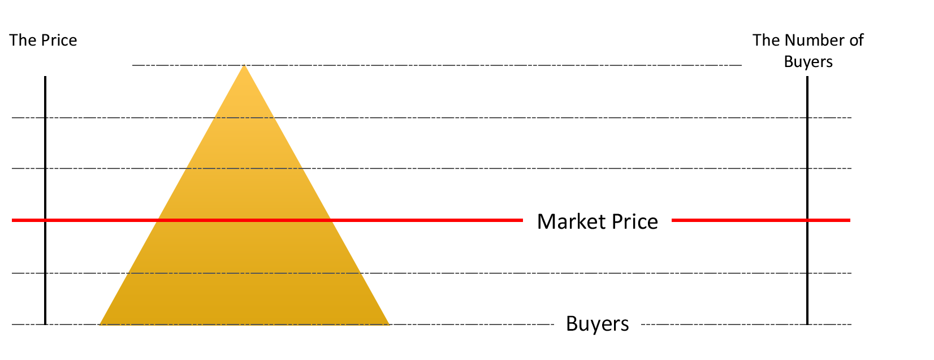
Overpricing
Marketing your home at right price is an important factor in the marketing of your home.
Properties that are priced too high will be left on the shelf by today’s renters.
© Copyright 2014 Clarke & Co Real Estate

Slide 7
Overview of Property
Check List for Landlords
Hardwire Smoke Alarm installed
Safety Switch installed
Fly Screens on all windows
Security Check. All Doors and Windows lock
Any other maintenance required
Landlords Insurance – Property Insurance Plus
© Copyright 2014 Clarke & Co Real Estate

Slide 8
Market Characteristics
Landlords Market
• Fewer homes For Rent
• Shorter average time on the market
• Prices may trend upwards
• More Renters
• Power to negotiate may be with the Landlord
Balanced Market
• Market moves at a good rate
• Prices are relatively stable
• Supply meets demand
Renter’s Market
• Over supply of homes For Rent
• Longer than normal times to lease properties out
• Fewer tenants at Open Inspections
• Prices may be trending downwards
© Copyright 2014 Clarke & Co Real Estate

Slide 9
Overview of Marketing Campaign
Database
Clarke & Co Real Estate Agents document prospective tenants details when they attend Open Inspections. We then add the potential tenants to our database. These potential tenants would be notified immediately when your property is listed for rent with us.
Internet
Your property will be listed on our website as well as the major real estate portals, including realestate.com.au, clarkeandcorealestate.com.au, realestateview.com.au, Domain and Facebook. The listing will include both property details and selected professional photos showing key features. The Internet is an important element of our marketing package. It is very powerful tool and continues to gain in popularity and gives potential tenants access Australia wide and internationally.
Photography
We provide quality photographs of your property emphasising key features be taken for advertisements, brochures and the Internet.
In our experience, quality photographs will attract a significantly higher number of inspections. Photos taken with devices that are not compatible to the internet present poorly and will attract less attention.
© Copyright 2014 Clarke & Co Real Estate

Slide 10
Marketing
Timing of Renting
There are several elements to have in place prior to the campaign commencing. These are photography, brochures and advertisements. We would begin working on these immediately upon appointment as your Property Management Agent
Shop Front Presence
Our office windows give our listed properties maximum exposure 24 hours a day. We would display your property on an A4 sized card for the duration of the campaign.
Email Marketing
Your property information will be sent out to our potential tenants on our data base.
© Copyright 2014 Clarke & Co Real Estate

Slide 11
Internet Marketing
realestate.com.au
clarkeandcorealestate.com.au
www.facebook.com/clarkeandcorealestate/
domain.com.au
Which are linked to a number of other sites
© Copyright 2014 Clarke & Co Real Estate

Slide 12
What are your Thought’s
By appointing Clarke & Co Real Estate to manage your property, we will take the stress out of the task with our professional service.
© Copyright 2014 Clarke & Co Real Estate

Slide 13
Thankyou for inviting Clarke and Co Real Estate to Appraise your Property.
© Copyright 2014 Clarke & Co Real Estate

