Slide 1
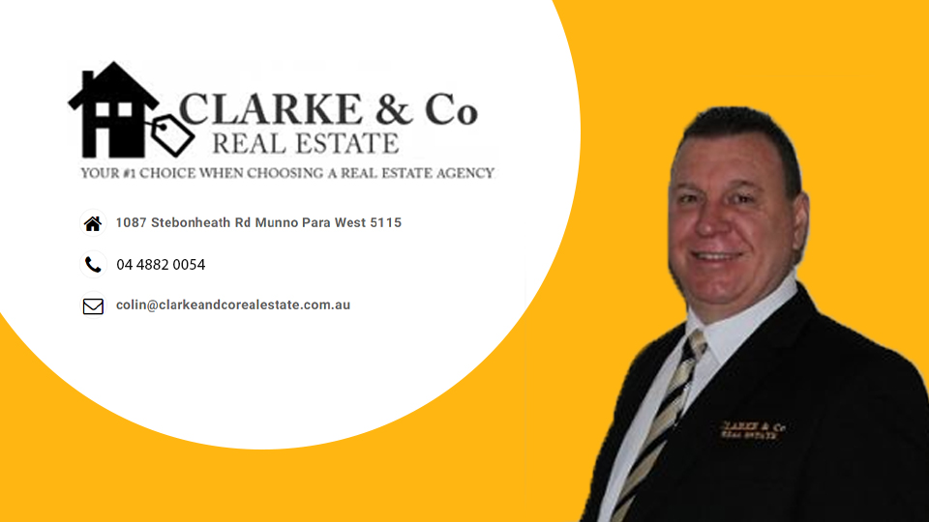
YOUR #1 CHOICE WHEN
CHOOSING A REAL ESTATE AGENCY
© Copyright 2014 Clarke & Co Real Estate

Slide 2
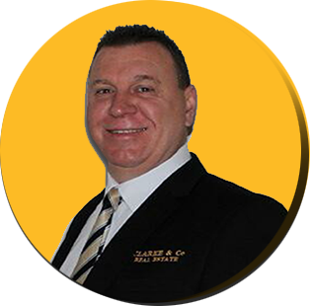
Property Appraisal
APPRAISAL PREPARED FOR:
A majority of Real Estate Franchises are owned by overseas companies.
Clarke & Co Real Estate is Australian owned. We employ local people and
contractors.
The money stays in South Australia.
PREPARED BY:
Colin Clarke
Director/Sales Consultant/Property Management
Mobile: 0448 820 054
89 Philip Highway Elizabeth South 5112
Phone: (08) 7324 4773
Email: colin@clarkeandcorealestate.com.au
Web: www.clarkeandcorealestate.com.au
RLA 243552
© Copyright 2014 Clarke & Co Real Estate

Slide 3
Introduction
This property appraisal has been prepared for the sale of XXXXXXXXXXXXXXXXXXXXXXXXXXX.
Thank you for giving me the opportunity to submit my appraisal. I would be delighted to act for you in
the marketing and sale of your property.
The opinion offered is based on current market conditions and our extensive selling experience in your
area. This opinion is not a legal valuation.
I look forward to being appointed as your agent. If you wish to clarify any of the information contained
in this proposal, please contact me at anytime before making a commitment to list your property.
Please do not hesitate to contact me on 08 7324 4773 or 0428 041 005.
Crystal Clarke
© Copyright 2014 Clarke & Co Real Estate

Slide 4
About Clarke & Co
A majority of Real Estate Franchises are owned by overseas companies.
Clarke & Co Real Estate is Australian owned. We employ local people and contractors.
The money stays in South Australia.
Clarke & Co Real Estate provides competitive and cost effective fees. We provide a marketing plan
that suits your budget.
Selling your property can be a highly emotional task. Our cost effective service will make the transaction
as smooth as possible and most of all we will save you money.
© Copyright 2014 Clarke & Co Real Estate

Slide 5
Market Analysis
After researching your property and the surrounding arrears we estimate a market
asking price range of $ to $
Our Professional Fee for the sale would be 2.25% of the Sale price.
60 Day Premiere Listing with Real Estate.com. Also Advertised on Real Estate View,
Clarke and Co Real Estate, Domain and Facebook.
Internet Advertising Real Estate.com $Quote
Internet Advertising Domain $110.
Professional Photographs, Floor plan and 50 Brochures is $340.
For Sale photo sign is Cost $360. or a Standard sign is $180
Marketing Budget $.
Note your Marketing Fee is paid on Settlement or if you withdraw the Property off the Market.
Administration Fee, Includes Form 1 Preparation $500. + GST
Timing of Sale
There are several elements to have in place prior to the campaign commencing, including relevant searches, photography,
brochures and advertisements. We would begin working on these immediately upon appointment as your selling agent.
© Copyright 2014 Clarke & Co Real Estate

Slide 6
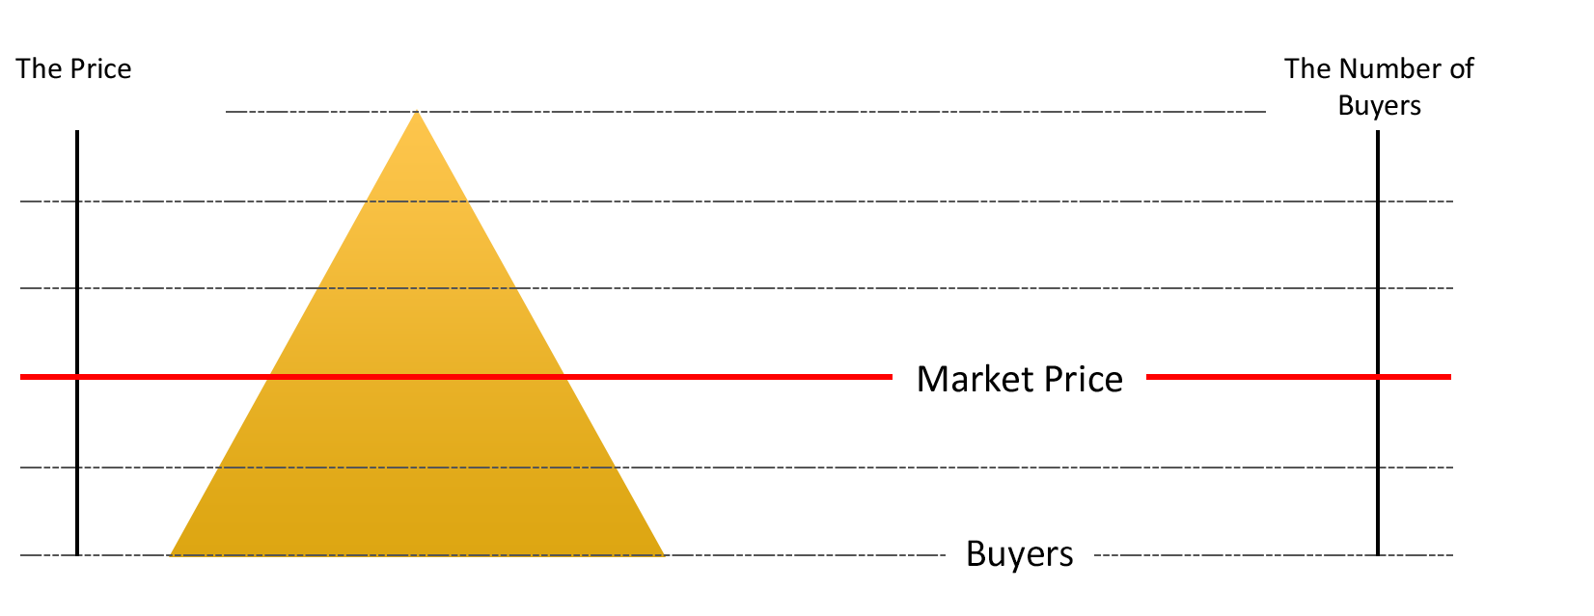
Overpricing
Marketing your home at right price is an important factor in the marketing of your home.
Properties that are priced too high will be left on the shelf by today’s renters.
© Copyright 2014 Clarke & Co Real Estate

Slide 7
Market Characteristics
Sellers Market
• Fewer homes For Sale
• Shorter average time on the market
• Prices may trend upwards
• More Buyers
• Power to negotiate may be with the Seller
Balanced Market
• Market moves at a good rate
• Prices are relatively stable
• Supply meets demand
Buyer’s Market
Over supply of homes For Sale
Lots of For Sale signs
Longer then normal sale times
Fewer buyers at Open Inspections
Prices may be trending downwards
Seller has less power to negotiate
Seller must meet the market to achieve a sale
© Copyright 2014 Clarke & Co Real Estate

Slide 8
Overview of Marketing Campaign
Photography
We provide quality photographs of your property emphasising key features be taken for advertisements, brochures and the Internet.
In our experience, quality photographs will attract a significantly higher number of inspections. Photos taken with devices that are not compatible to the internet present poorly and will attract less attention.
Shop Front Presence
Our office windows give our listed properties maximum exposure 24 hours a day. We would display your property on an A4
sized card for the duration of the campaign.
Internet
Your property will be listed on our website as well as the major real estate portals, including realestate.com.au,
clarkeandcorealestate.com.au, realestateview.com.au, Domain and Facebook. The listing will include both property details
and selected professional photos showing key features.
The Internet is an important element of our marketing package. It is very powerful tool and continues to gain in popularity
and gives potential purchasers access Australia wide and internationally.
© Copyright 2014 Clarke & Co Real Estate

Slide 9
Quality Brochures
© Copyright 2014 Clarke & Co Real Estate

Slide 10
Internet Marketing
realestate.com.au
clarkeandcorealestate.com.au
www.facebook.com/clarkeandcorealestate/
domain.com.au
Which are linked to a number of other sites
© Copyright 2014 Clarke & Co Real Estate

Slide 11
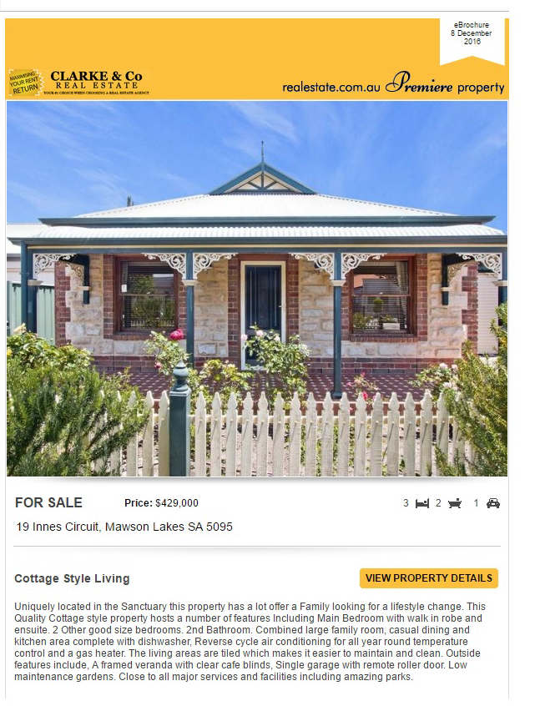
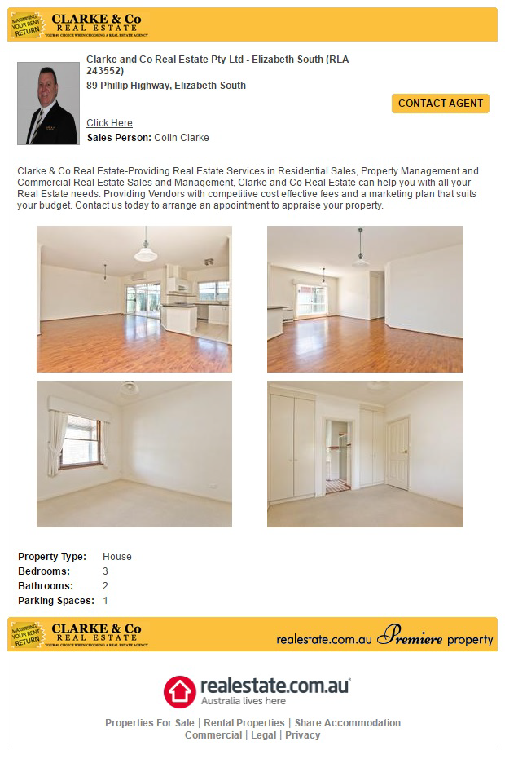
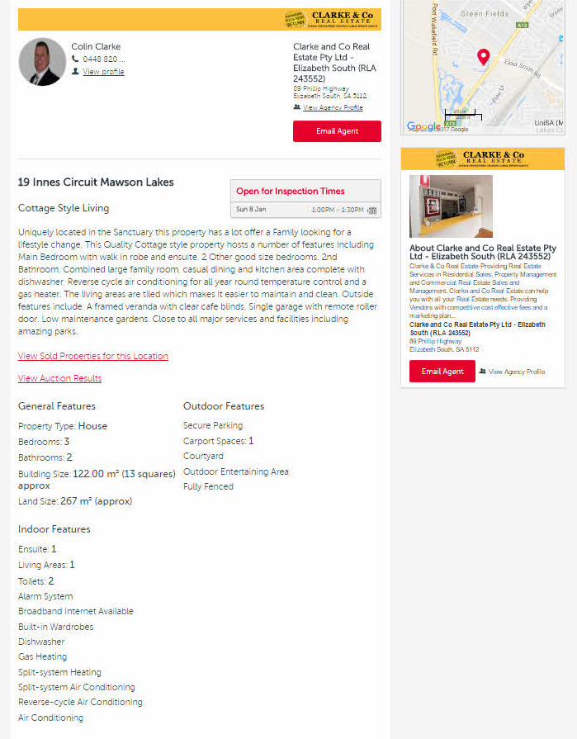
Premier Listing with Real Estate.com
© Copyright 2014 Clarke & Co Real Estate

Slide 12
Marketing
Database
Clarke & Co Real Estate Agents document purchasers details who attend Open Inspections. We then add the potential purchasers
to our database. These potential purchasers would be notified immediately when your property is listed for sale with us.
Email Marketing
Your property will be sent out to our potential purchasers on our data base.
Signboard
The sign board is optional. The signboard acts as a “silent salesman” and will attract significant buyer enquiry.
© Copyright 2014 Clarke & Co Real Estate

Slide 13
Signboards
Signboards are an excellent way of advertising your property 24/7.
© Copyright 2014 Clarke & Co Real Estate

Slide 14
Our Service
We take care of everything else as follows
Write the advertisement on the property.
Appoint a photographer to take the photos/floor plan and supply brochures of the property.
Arrange a For Sale sign.
Advertise the property on the Internet, with a marketing plan that suits you.
Arrange council searches and Form 1 preparation.
Follow up purchaser enquiries.
Negotiate the best and highest price for you.
Execute the Contract of Sale and Form 1 on your property.
Follow through the contact until settlement
Our traditional full service “WE DO EVERYTHING”
© Copyright 2014 Clarke & Co Real Estate

Slide 15
What are your Thought’s
A good sales consultant will gain you concessions.
A poor consultant will give them away.
© Copyright 2014 Clarke & Co Real Estate

Slide 16
Thankyou for inviting Clarke and Co Real Estate to Appraise your Property.
© Copyright 2014 Clarke & Co Real Estate

